Slide 1
Public Consultation
Nature recovery
January 2025

Slide 2
Agenda
What we'll cover today:
Project overview: What is the Local Nature Recovery Strategy?
Public consultation: What we're aiming to find out
Commissioning opportunity: Work with us
Key dates
Questions and contacts
Notes:
Housekeeping and welcome
Anything you're not sure of just let us know

Slide 3
Emma Galbraith
Environment Officer

Slide 4
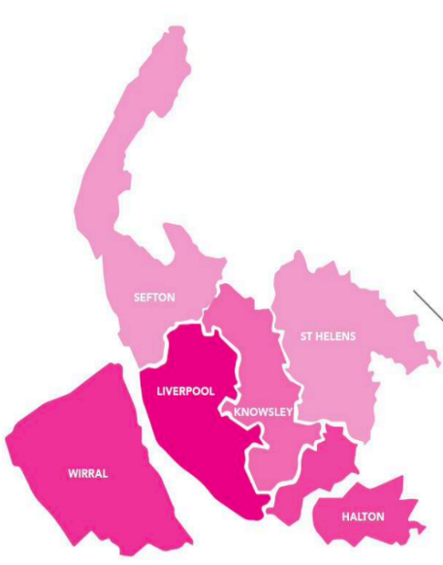
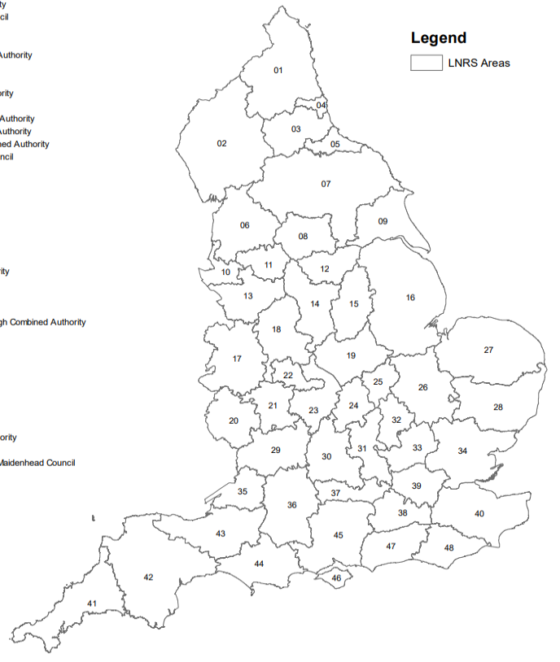
Project Outline
What is a Local Nature Recovery Strategy?
An evidence-based and locally-led spatial strategy, designed to provide a joined-up, regional approach to nature recovery.
Consists of a written strategy document and a digital map.
Sets priorities for nature recovery and maps opportunities for habitat enhancement, restoration and creation, where the biggest benefit will be felt to both nature and people.
Introduced in The Environment Act (2021): 48 LNRSs across England.
Globally, biodiversity is in serious decline following centuries of habitat destruction. The UK has lost nearly 50% of its biodiversity, placing it in the top 10% most nature depleted countries in the world. The Liverpool City Region is no exception to this.
© DEFRA

Slide 5
Project Outline – use of maps
The map acts as a blueprint for nature recovery.
Identifies specific locations where there is a particular opportunity to implement nature recovery action.
Each location is assigned a suggested action that would result in the biggest biodiversity benefit and wider benefit to people.
Opportunities are colour-coded and grouped into habitat type and priority species.
Can be used by anyone wishing to take action for nature recovery at any scale: local authorities, developers, conservation organisations, community groups and individuals.

Slide 6
Project Outline
What we want to find out
Have we got the priorities right?
Have we missed any opportunities for nature recovery?
Is there anything we’ve got wrong?
Is it easy to understand/use?
What do people need to be able to take action? (guidance, funding, support, partnerships)

Slide 7
Questions

Slide 8
Work with us
Chloe Payne
Engagement Officer

Slide 9
Who we want to speak to – audience
The audience is people who are digitally excluded and living in Halton, Knowsley, St Helens or Wirral.
For the purposes of this commission, being ‘digitally excluded’ means not having access to the internet or a computer/laptop/ipad/smart phone and/or not having the necessary skills to be able to take part in an online survey.

Slide 10
Deliverables and budget
Your proposal should focus on how you will adapt the map for an offline audience.
Your activity must take place in Halton, Knowsley, St Helens or Wirral.
We are keen to hear creative and innovative ways of engaging communities.
There is a total budget of £6,000 for this work
You’ll need to submit a written report of findings.
Notes:
Interested organisations are asked to review the draft survey framework and the example habitat map and use them to design and deliver an activity or activities which will gather feedback and understanding on the strategy.
Focus groups, workshops and one-to-one interviews are all legitimate methods of engagement; however, we are open to other suggestions and ideas and we are keen to hear your most creative and innovative ways of engaging communities
6k which may be allocated to up to two organisations or a consortium of organisations. We would consider appointing the full budget to one organisation if they were able to effectively engage with a range of residents and ages across all four council areas listed.

Slide 11
Tips for applying
1. Provide evidence
2. Be specific
3. Show off your expertise
Please read the supplier brief before applying it contains tips to make your answers stand out, info on scoring and FAQ’s.
Notes:
The map is going to be the focus of the work – however we will help whoever is appointed to understand it in more detail and we will provide you will specific questions too – what we are looking for in your application is that you have established links with people in these communities, you are experienced at engaging people in an offline way, and you can deliver the work.
1. Provide examples and evidence:
The highest scores will be given to those responses which demonstrate they have existing links within the community, are able to recruit a diverse range of people to take part and have evidence to support the recommendations.
2. Be specific:
Who do you plan to speak to and what are your planned activities?
Are you able to engage with a range of ages, genders, ethnicities and people with different levels of interest in nature recovery – if so, explain how you will
do this. What is the rationale for your proposals? Why is your chosen method an effective way to engage? How will your proposals result in high quality and
detailed responses? We are also looking for reassurance that you will be able to deliver within the timescales, so consider what does your project plan look like?
3. Show off your expertise:
Tell us, why is your organisation the best for this project? We are looking for evidence that your organisation has good knowledge of how best to engage with citizens living in one of the four council areas listed in the brief and adults who are digitally excluded. Explain and evidence that you understand the needs of this target audience and know the best ways to engage them to get the best outcomes.

Slide 12
Key Dates
Applications close | 23:59 Friday 24 January 2025
Successful organisation(s) appointed | Week commencing 27 January 2025
Community engagement delivery | 17 Feb until 28 March 2025
Final report submission | 4 April 2025
Notes:
Applications close 23:59 on TBC
It's a simple online application process – you'll hear back week commencing 27 January 2025

Slide 13
Questions
LCRListens@liverpoolcityregion-ca.gov.uk​
Notes:
For questions about the commissioning process you can contact us via email

