Slide 1
Public Consultation
Local Transport Plan
September 2024

Slide 2
Agenda
What we'll cover today:
Project overview: What is a Local Transport Plan?
Public consultation: What we're aiming to find out
Commissioning opportunity: Work with us
Key dates
Questions
Contacts
Notes:
Housekeeping and welcome
Chris to introduce herself, Sean, Ya Ching and Chloe
Questions can be submitted in the chat, or by raising virtual hand
Anything you're not sure of just let us know

Slide 3
Sean Maher
Policy Officer

Slide 4
Project Outline
What is a Local Transport Plan?
The draft Local Transport Plan outlines our plans for the movement of people and goods in Liverpool City Region up to 2040. It sets out how we will invest in and transform, the public transport and road networks in Halton, Knowsley, Liverpool, Sefton, St Helens and Wirral to make travelling by public transport and active travel easier, cheaper and more accessible for everyone.
Our aim is for the Liverpool City Region to be the best place to grow up, grow a family, and grow a business – where no-one is left behind.
We know that a good public transport system is key to this, it can provide access to new jobs, connect people to more opportunities and help create homes and places that are vibrant, attractive and welcoming for everyone.
This is 2nd public consultation
Notes:
It sets out how we will invest in and transform, the public transport and road networks in Halton, Knowsley, Liverpool, Sefton, St Helens and Wirral to make travelling by walking, cycling, wheeling and public transport especially easier, cheaper and more accessible for everyone.

Slide 5
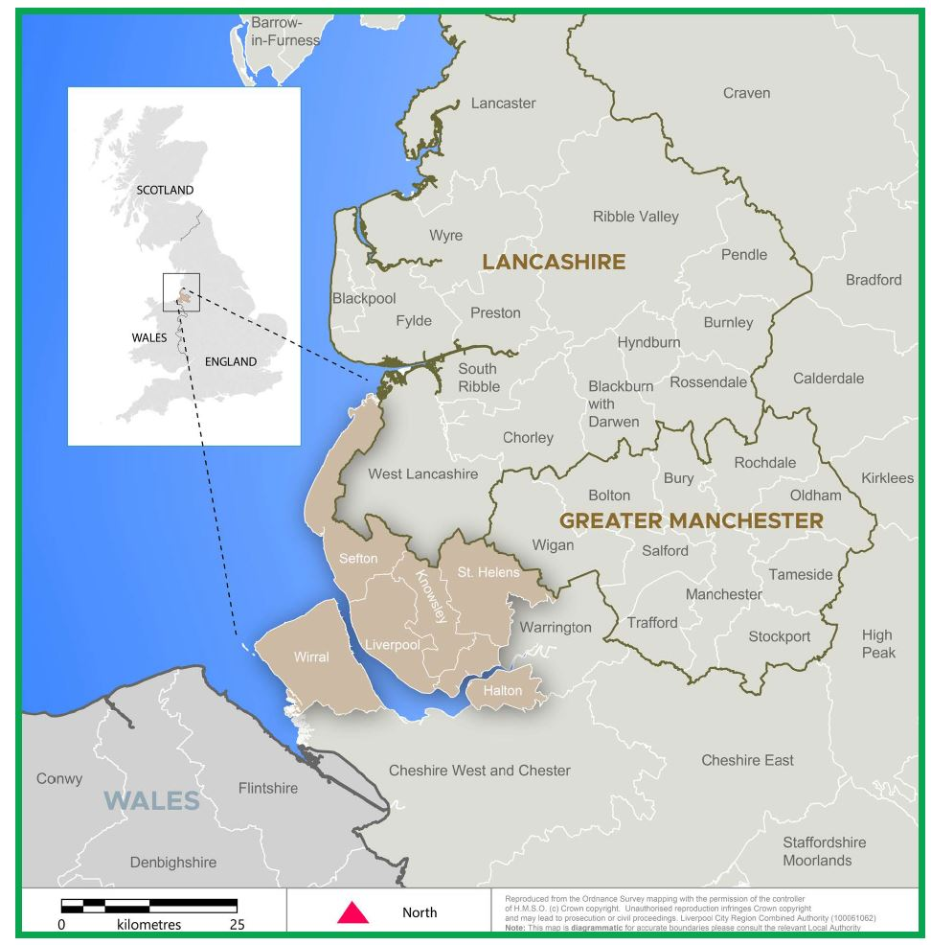
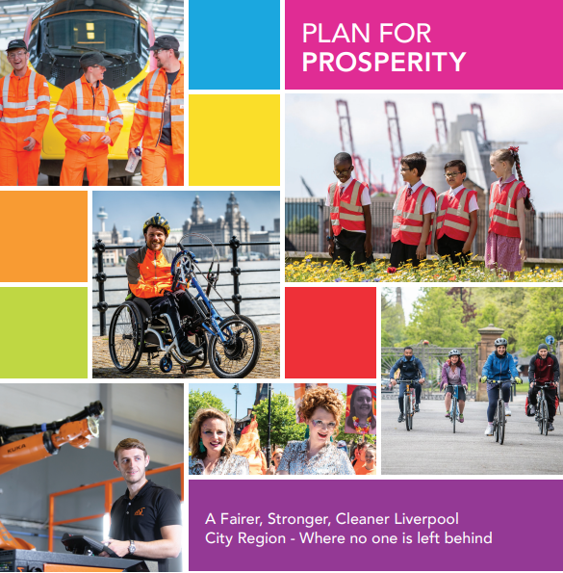
The Vision
“To plan and deliver a future-facing, clean, safe and accessible transport system built to last. It will focus on moving people, goods and freight around the region in a way that delivers our local ambitions. A particular focus will be on a net zero carbon emitting city region by 2035.”
Summarised as: “Clean, safe and accessible transport for moving people and goods.”
LTP4 contains:
Vision with Five clear goals
Eight core principles
21 policies

Slide 6
Project Outline
Delivering the Local Transport Plan
The vision is supported by 5 goals
GOAL 1: Support good, clean job growth and opportunity for all.
GOAL 2: Achieve net-zero carbon and an improved environment.
GOAL 3: Improve health and quality of life.
GOAL 4: Transport that’s well maintained and tough.
GOAL 5: Plan and respond to uncertainty and change and be innovative.

Slide 7
Questions

Slide 8
Work with us
Chris Murphy
Engagement Officer

Slide 9
Public Consultation
There are 21 policies in the plan.
We're asking the public, what do you think is good about each policy? Do they have any concerns or worries about it? How could we reduce their concerns?
Public consultation is open from 3rd October to 15th December 2024.
Citizens and businesses can give their views via an online or paper survey.
Feedback will then be used to shape how we deliver the aims in the policy, before the plan is finalised in 2025.
Notes:
The Local Transport Plan contains 21 policies which set out how we will reduce carbon emissions to create a public transport that is tough to climate change, gives people more choices and helps us all to lead healthier and happier lives.
In 2022 we asked if people agreed with our vision and goals and used it to develop this plan, we now want to hear your views on the policies we’re proposing. Tell us, what do you like the sound of? What have we not thought of and how can we make sure transport works for everyone in our region?
The public consultation will help us to understand a wide range of views and inputs to enhance and improve proposed policies ahead of next stage.

Slide 10
Work with us – what we are commissiong
We're commissioning up to three organisations to help us engage with the following groups:
Older people aged 55+
People from Black, Asian and other Minority Ethnic groups.
People from lower socio-economic backgrounds
Open to all community organisations signed up to our Community Suppliers Network
You know your communities best - tell us how you plan to engage with the community in your proposal – choose a minimum of four policies.
Notes:
The survey is open to everyone but we know there are some groups in society who won't get involved or have their say. Which is why we are commissioning community engagement support.
We'd like to hear from these three groups of people, we are also doing some separate work on making sure people who are digital excluded can take part.
Lower socio-economic backgrounds for this consultation is defined as people living in Liverpool City Region’s most deprived communities. We’re particularly interested in hearing from communities in East Wirral, North Liverpool, South Sefton and Knowsley. This could be people who are unemployed, have a low income or work in a semi-skilled or unskilled job and/or claim benefits or use a food bank
You must be a community organisation to apply and be signed up to our community suppliers network - i.e Charitable Company, Community Interest Company (CIC), Charitable Incorporated Organisation (CIO), Social Housing Provider, Community Benefit Society, Trust, Other Registered Charity and Unincorporated Association.
You know your community best – tell us in your proposal how you'll engage.
There are 21 policies in the plan and you'll need to engage on a minimum of 4 policies and we'll provide some guidance on the policies in the commissioning pack.
We're open to all types of proposals -focus groups/workshops/interviews - due to the level of detail required in the final report, we will not consider artwork responses.
Demographic data must be recorded and a final report produced.

Slide 11
Deliverables and budget
We're asking you to find out: the level of support for each policy, what people think is good and what concerns they might have.
Engagement activity must take place before 15 December with one or more of the specified groups. You don't need to engage them all.
Final report of feedback and recommendations due 20 December 2024
Total budget of £8,000 is available – this may be allocated to up to three organisations but we would also consider awarding it to one organisation who could engage with all three groups.
Notes:
Engagement activity must take place before 15th December with one or more of the specified groups.
A final report of findings and recommendations to be delivered by 20th December
Total budget of £8,000 is available - this may be allocated to multiple organisations.
You can incentivise participation in the engagement and provide refreshments, this will need to be clearly costed in your proposal.
The commissioned organisation(s) will be asked to summarise the demographic data of participants mirroring what is asked in the survey, the number of people engaged, a response to each of the policies they have chosen and a produce a final report with a set of recommendations, which we will provide a template and guidance on.

Slide 12
How to apply
Applications will open later today and close 23:59 on Tuesday 8 October.
It's a simple online application process – you'll hear back week commencing 14 October.
We'll share guidance and a commissioning brief after this meeting.
Scoring is 90% quality of response and 10% cost.
Notes:
Applications will open later today and close 5pm on Tuesday 8th October – we will send you the details after this meeting.
It's a simple application form – asking: who you will engage with and how many people, what your proposals are and how much they will cost.
We'll provide you with a full commissioning brief and an example discussion guide to help you structure your response.
You'll need to demonstrate a good value for money. For example if you ask for £500 but only engage with 5 people, this would not demonstrate good value for money.

Slide 13
Key Dates
Applications open | Tuesday 24 September 2024
Applications close | 23:59 Tuesday 8 October 2024
Successful organisation(s) appointed | w/c 14 October 2024
Community engagement delivery | 21 October to 15 December 2024
Final report submission | 20 December 2024
Notes:
While the commissioning work takes place - public consultation is open 3rd October until 15th December.
Invoices will be paid after the final report is submitted – we will work with you to make sure this is done as quickly as possible – but important to highlight in some cases the payment may be in the new year. If organisations have upfront costs we can look at part payments.

Slide 14
Questions
LCRListens@liverpoolcityregion-ca.gov.uk​
Notes:
For questions about the commissioning process you can contact us via email

